Slide 1

Tip of the Day
Try using these
Keyboard Shortcuts to save time while creating your websites!
Action | Keys
Copy | Ctrl+C
Paste | Ctrl+V
Undo | Ctrl+Z
Save | Ctrl+S

Slide 2
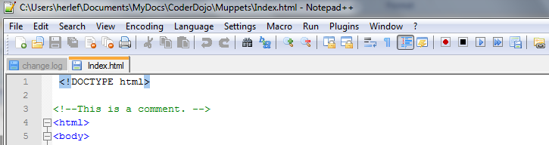
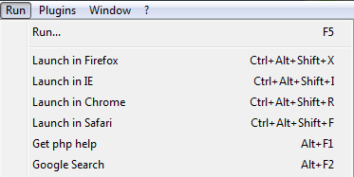
Tip of the Day
In Notepad++, instead of closing and opening files all the time use “Run - Launch in Browser”

Slide 3
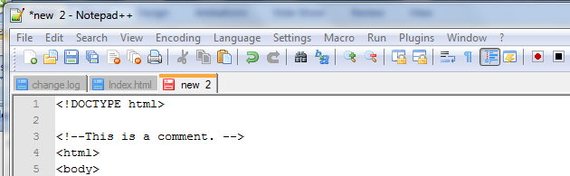
Tip of the Day
When you open a new file, give it a name and save it straight away. Otherwise if you close it, your work might be gone

Slide 4
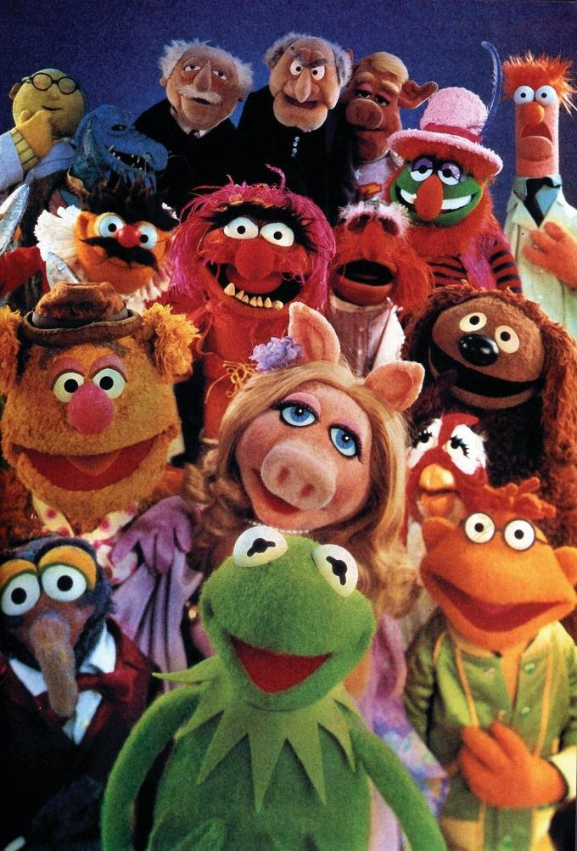
Tip of the Day
To “grab” a picture / background you like, use the “Prnt Scrn” button to save the screen to the clipboard. Then use CTRL + V to paste it into your file

